Slide 1
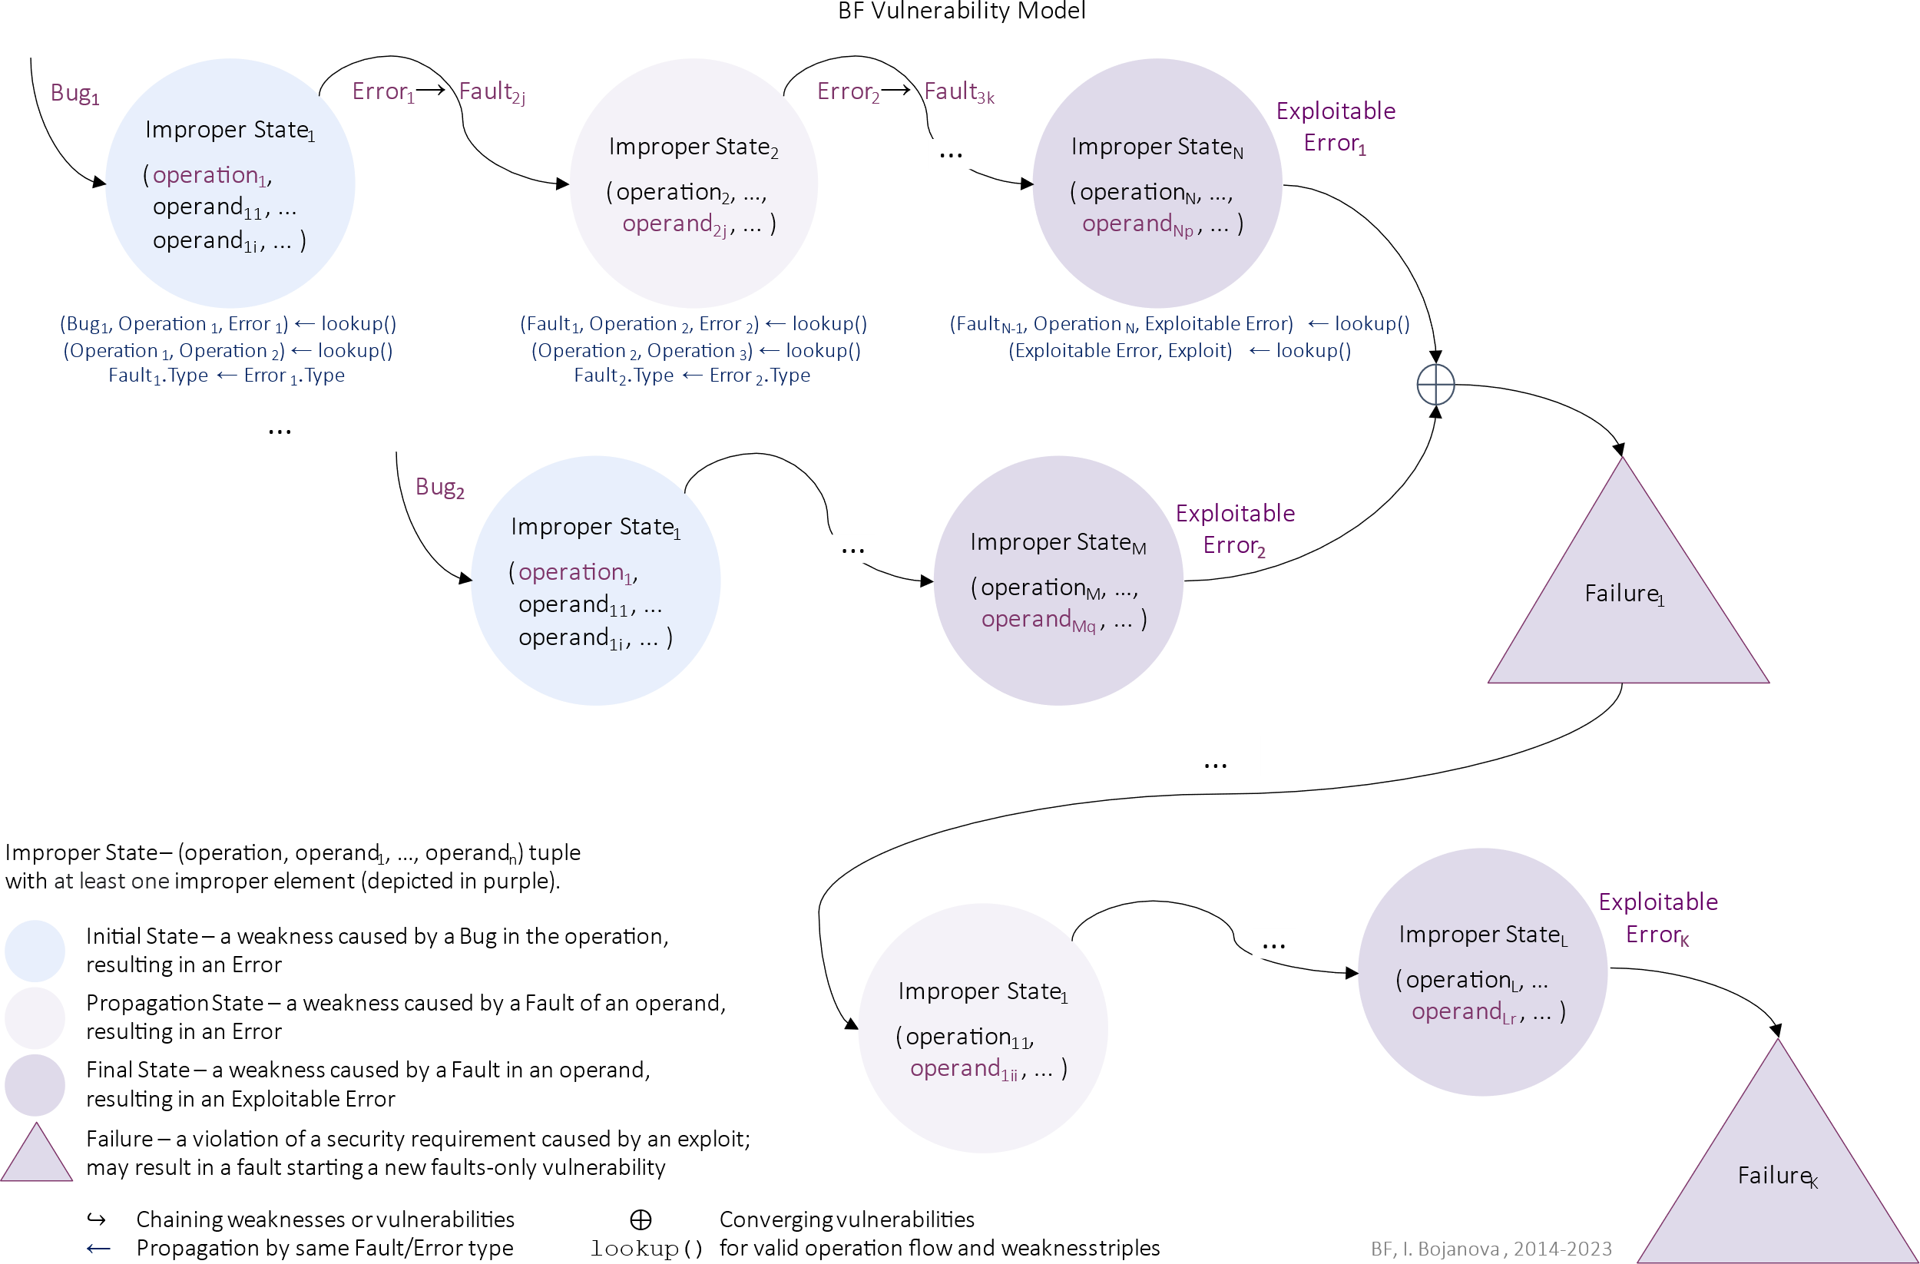
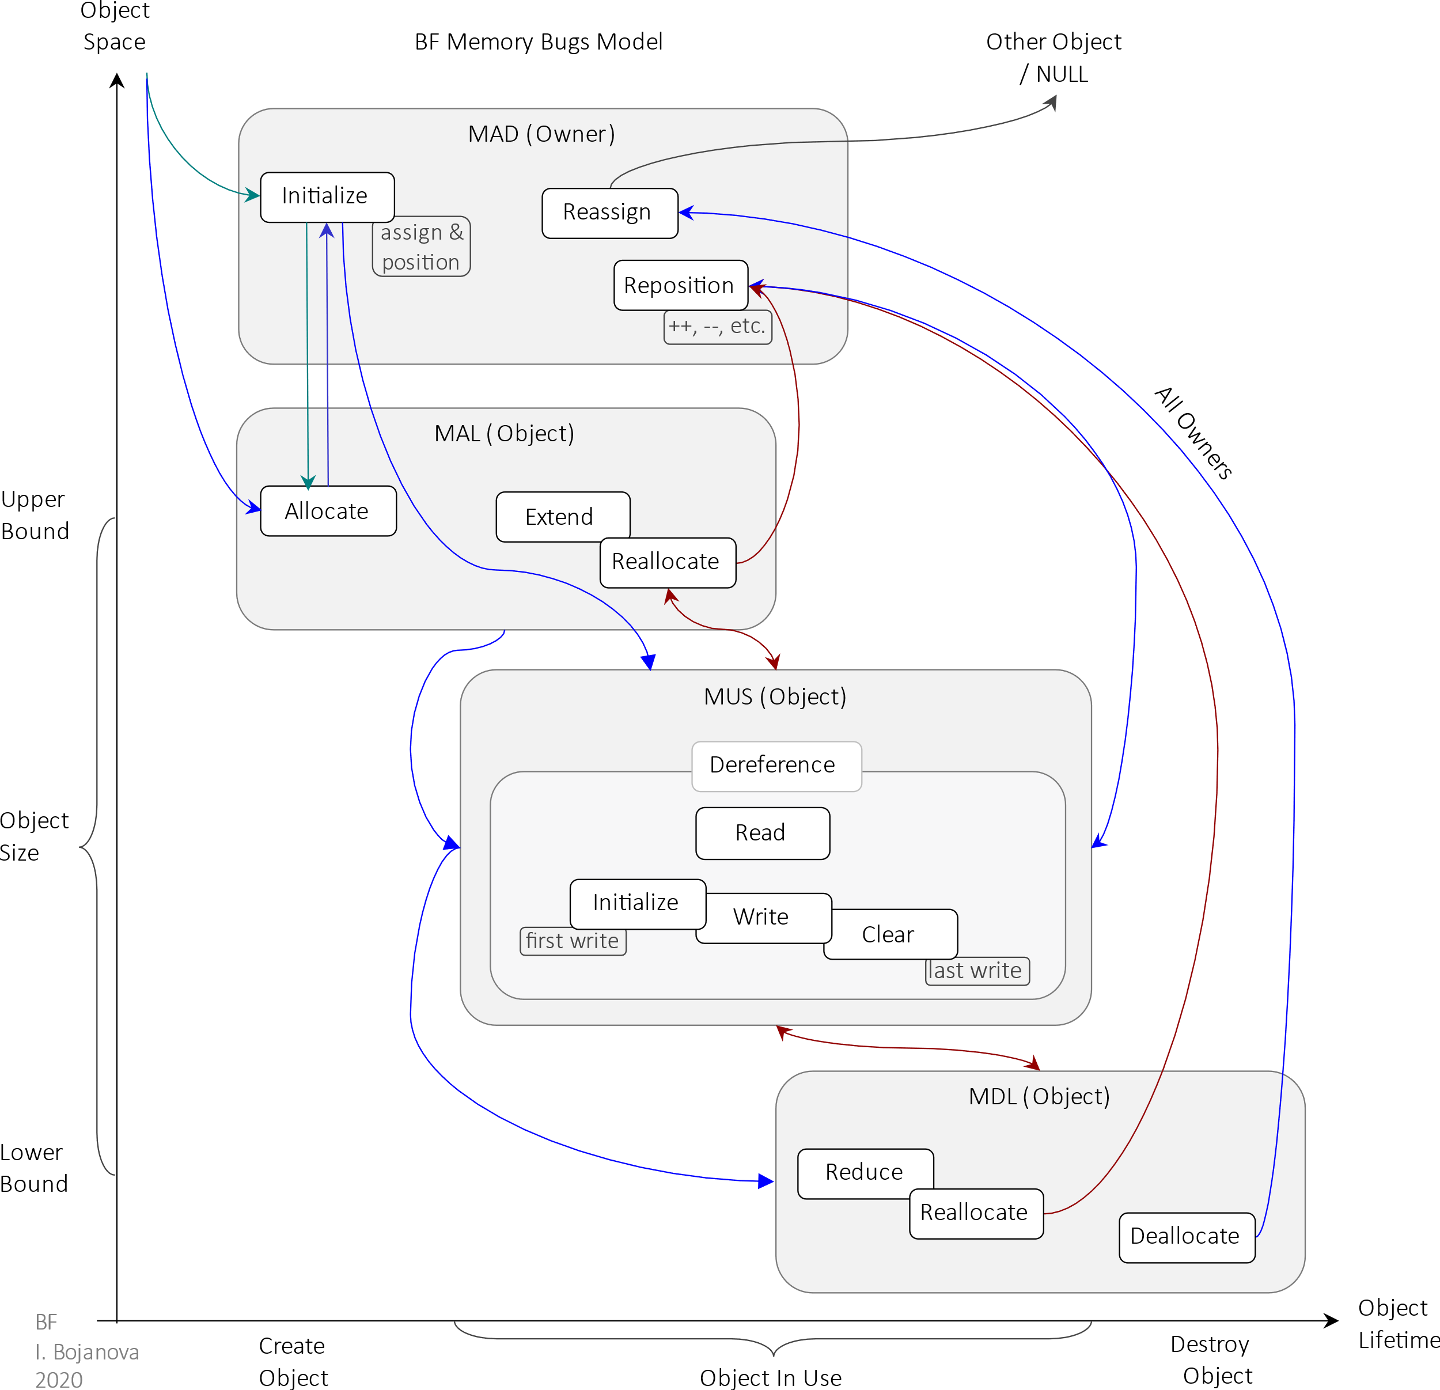
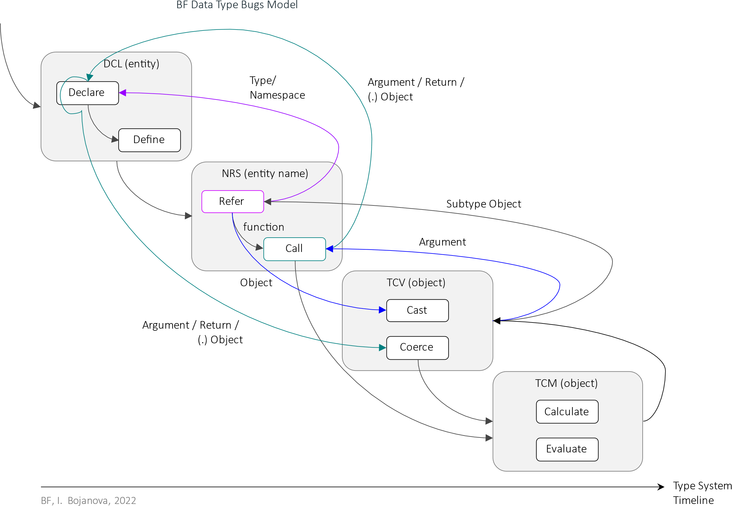
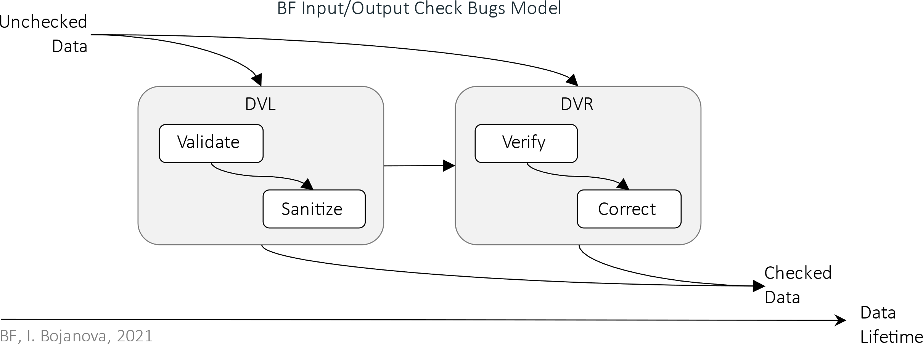
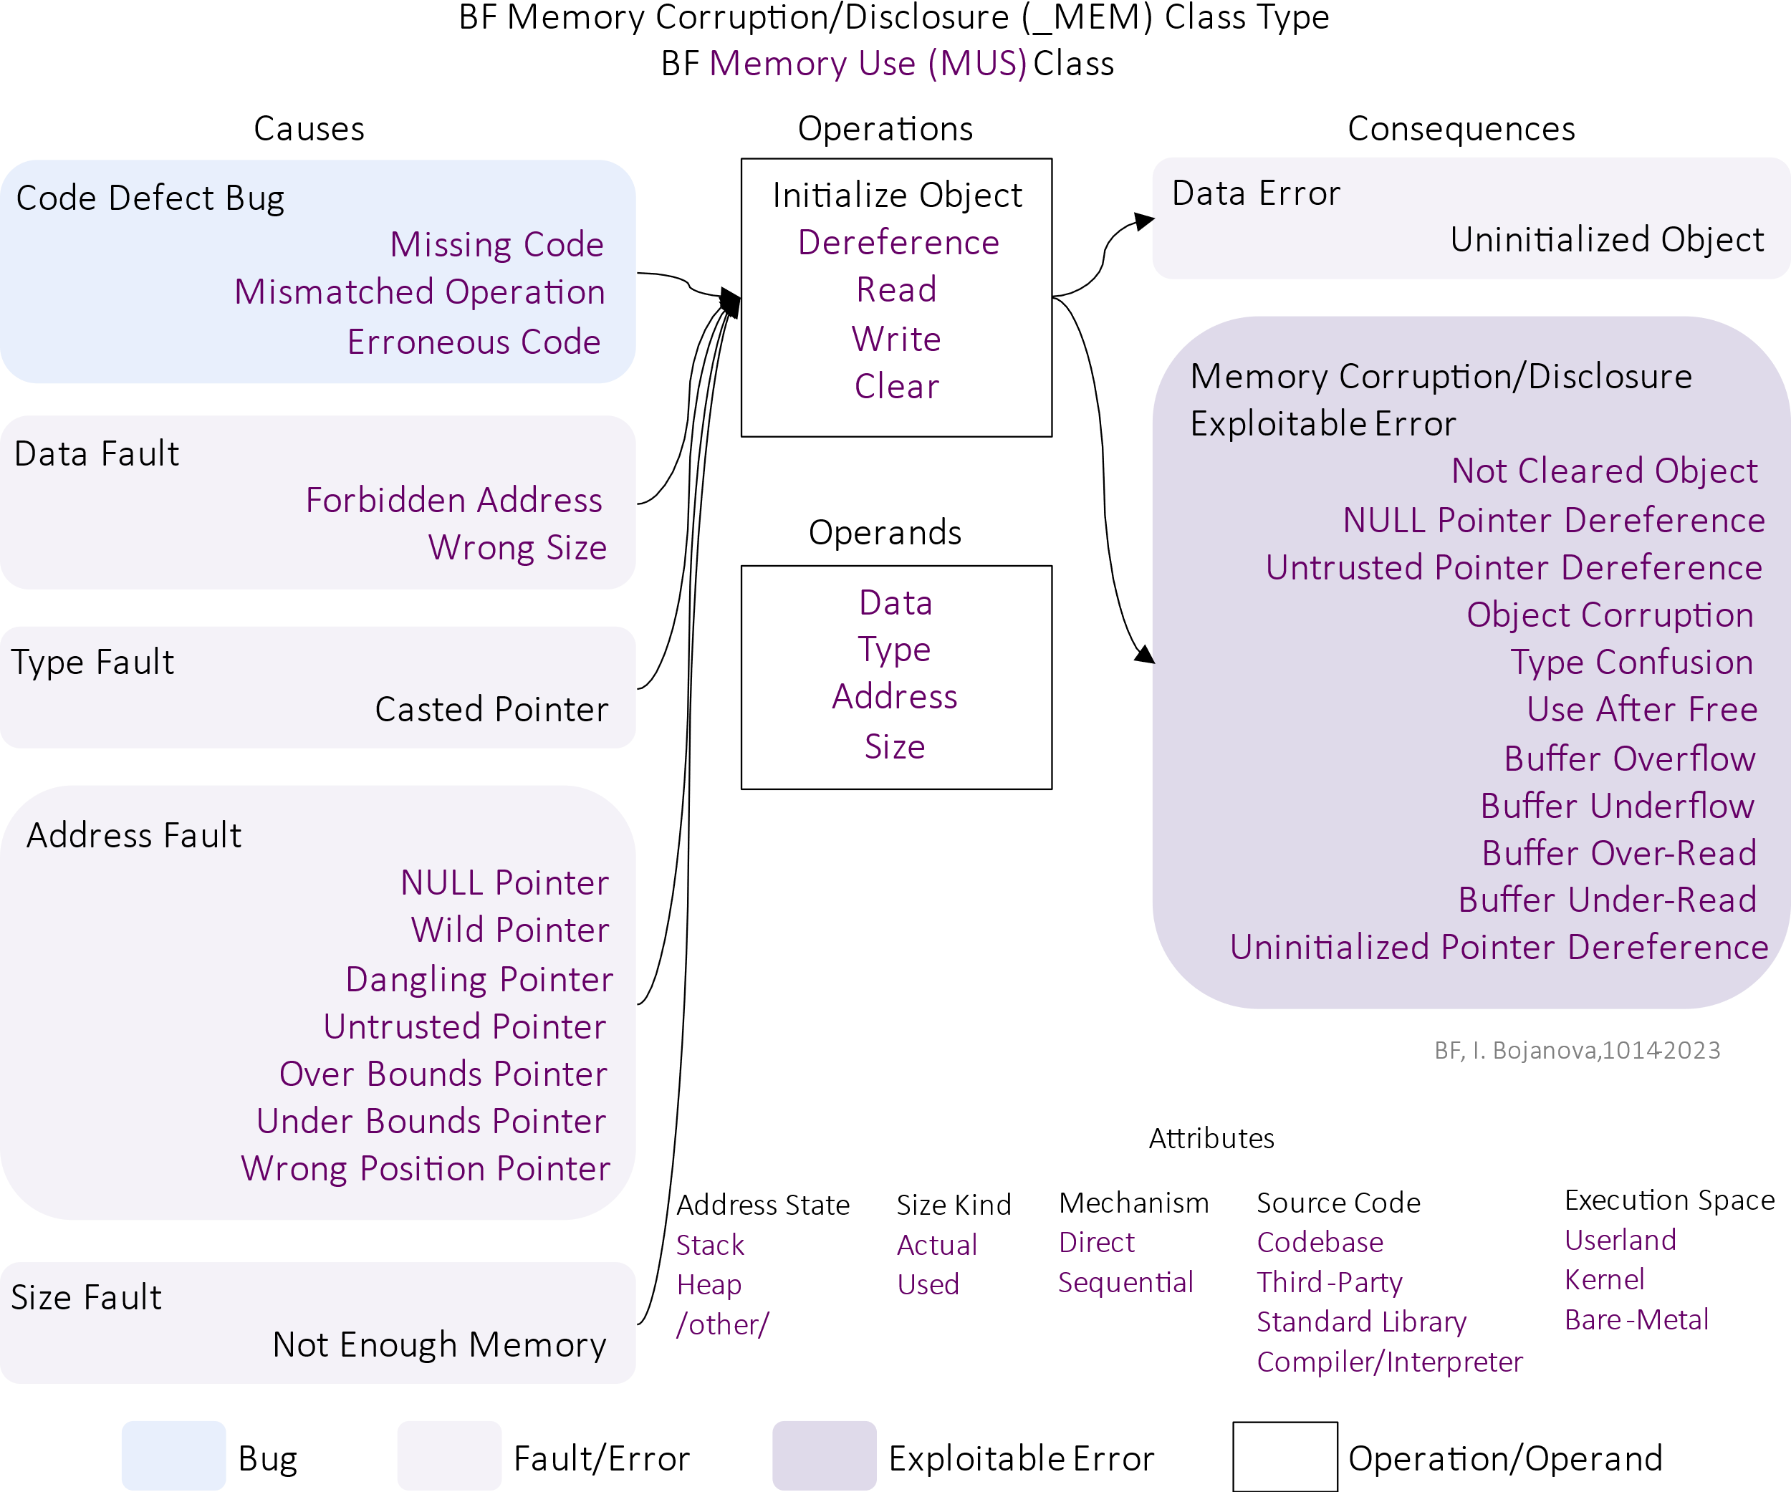
ITL Science Day
Bugs Framework (BF) Formalizing Software Security Bugs, Weaknesses, and Vulnerabilities
Irena Bojanova, NIST
Motivation
Crucial need of a formal classification system allowing unambiguous specification of software security bugs and weaknesses, and the vulnerabilities that exploit them.
Objective
Create bug models, weakness taxonomies, and vulnerability models with causation and propagation rules; and an unambiguous formal weakness/vulnerability specification language.
BF Vulnerability Model
Chains of weaknesses
Start with a bug
Propagate via errors becoming faults
Lead to failures
May chain via faults from failures
May converge at exploitable errors
BF Bug Models
Bug/Fault Type related software execution phases with non-overlapping operations
Causation between weaknesses – by operation flow
Secure coding principles – e.g.,
Input/Output Safety
Data Type Safety
Memory Safety
BF Formal Language
BF CFG¹ is a G = (V, Σ, R, S) tuple with finite sets of tokens Σ = { α | α is BF taxon} ∪ { ⊕, lookup() }, variables V, rules R = { A → ω | A ∈ V, ω ∈ (V ∪ Σ)* }, and a predefined start S ∈ V
BF LL(1)² Attribute CFG³ is BF CFG derived via left-factorization and left recursion elimination
Syntax Rules
S → Vulnerability Converge_Failure
Vulnerability → Bug Operation OperAttrs_Error_ExplError
OperAttrs_Error_ExplError → Oper_Attr OperAttrs_Error_ExplError
| Error Fault OprndAttrs_Operation
| Exploitable_Error
OprndAttrs_Operation →
Operand_Attr OprndAttrs_Operation
| Operation OperAttrs_Error_ExplError
Converge_Failure →
⊕ Vulnerability Converge_Failure
| Exploit NextVulner_Failure
NextVulner_Failure → Fault Operation OperAttrs_Error_ExplError
| Failure ε
Semantic Rules
(Bug | Fault, Operation, Error | Exploitable Error) ← lookup()
Fault.Type ← Error.Type
Exploit.Type ← Exploitable Error.Type
BF formal language is the BF LL(1) CFG generated set of all strings derivable from S:
L(G) = { α ∈ Σ* | S⇒*α }
A string starts from S and ends with ε (the empty string) by applying the A → ω production rules regardless of context.
BF Weakness Taxonomies
Weakness Types with valid cause-operation-consequence relations – e.g., the BF MUS class:
Taxons – types (in black) and values (in purple)
Operations and operands
Causes and consequences
Attributes of operations and operands
Causation within weaknesses – all valid triples (Bug/Fault, Operation, Error/Exploitable Error)
Structured – cause-operation-consequence
Complete – no gaps in coverage
Orthogonal – no overlap by operation
Context-free – programming language and application domain independent
BF LL(1) ⇒ unambiguous BF specifications!
Lexis – BF taxons
Syntax – BF vulnerability models’ flow
Semantics – causation & propagation (BF bug models operation flow, valid taxon triples, vulnerability model propagation).
¹ CFG – Context-Free Grammar; ² LL(1) – Left-to-right Leftmost-derivation One-symbol-lookahead; ³ Attribute CFG – adds attributes, and semantic and predicate functions.
Potential Impact
Models and a formal language for unambiguous bug, weakness, and vulnerability specifications – for use by professionals, AI algorithms, and systems for training, data generation, and research.
10/5/2023
BF, I. Bojanova, since 2014

